Slide 1
MATH221
Mathematics for Computer Science
Unit 11
Probability

Slide 2
Learning Objectives
Fundamentals knowledge of probability
Conditional Probability
Bayes’ Theorem
Independent Events

Slide 3
1: Probability Axioms

Slide 4
Probability Axioms
Probability Axioms
Recall: a sample space is a set of all outcomes of a random process or experiment and that an event is a subset of a sample space.
Probability Axioms
Let S be a sample space. A probability function P from the set of all events in S to the set of real numbers satisfies the following axioms: For all events A and B in S,
0 ≤ P(A) ≤ 1
P(∅) = 0 and P(S) = 1
If A and B are disjoint (A ∩ B = ∅), then
P(A ∪ B) = P(A) + P(B)

Slide 5
Probability Axioms
Probability of the Complement of an Event
Suppose that A is an event in a sample space S. Deduce that P(A^{c}) = 1 – P(A).
By Complement Laws:
(a) A ∪ A^{c} = U and (b) A ∩ A^{c} = ∅
With S playing the role of the universal set U,
A ∪ A^{c} = S and A ∩ A^{c} = ∅
Thus S is the disjoint union of A and A^{c}, and so
P(A ∪ A^{c}) = P(A) + P(A^{c}) = P(S) = 1
Subtracting P(A) from both sides:
P(A^{c}) = 1 – P(A)

Slide 6
Probability Axioms
Probability of the Complement of an Event
Probability of the Complement of an Event
If A is any event in a sample space S, then
P(A^{c}) = 1 – P(A)

Slide 7
Probability Axioms
Probability of a General Union of Two Events
Probability of a General Union of Two Events
If A and B are any events in a sample space S, then
P(A ∪ B) = P(A) + P(B) – P(A ∩ B).
Note: This unit shall focus on the use of all these basic properties. However, their proofs can be fund in supplementary notes.

Slide 8
2: Conditional Probability, Bayes’ Theorem, and Independent Events

Slide 9

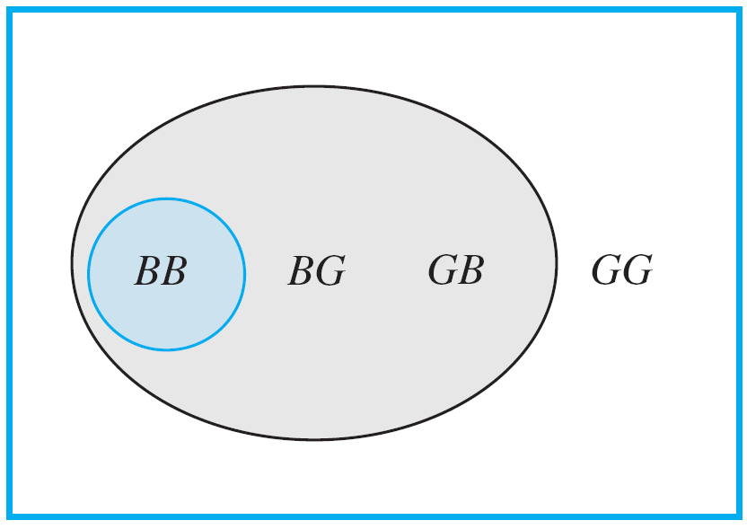
Conditional Probability
Conditional Probability
Imagine a couple with two children, each of whom is equally likely to be a boy or a girl. Now suppose you are given the information that one is a boy. What is the probability that the other child is a boy?
New sample space = gray region.
Figure 11.11.1

Slide 10

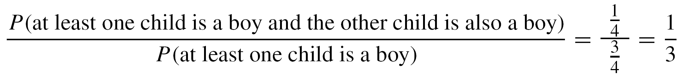
Conditional Probability
Within the new sample space, there is one combination where the other child is a boy (blue-gray region).
Hence, the likelihood that the other child is a boy given that at least one is a boy = 1/3.
Figure 11.8.1
Note also

Slide 11
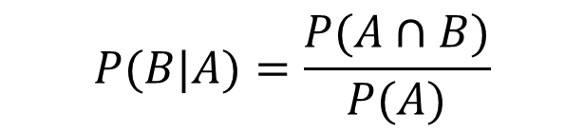
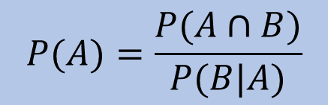

Conditional Probability
A generalization of this observation forms the basis for the following definition.
Definition: Conditional Probability
Let A and B be events in a sample space S. If P(A) ≠ 0, then the conditional probability of B given A, denoted P(B|A), is
$$P(B|A)=\frac{P(A∩B)}{P(A)}$$
11.8.1
Multiplying both sides of formula 11.8.1 by P(A), we get
Dividing both sides of formula 11.8.1 by P(B|A), we get
$$P(A∩B)=P(B|A)∙P(A)$$
$$P(A)=\frac{P(A∩B)}{P(B|A)}$$
11.8.2
11.8.3

Slide 12

Conditional Probability
Example 1 – Representing Conditional Probabilities in a Tree Diagram
An urn contains 5 blue and 7 gray balls. Let us say that 2 are chosen at random, one after the other, without replacement.
Find the following probabilities and illustrate them with a tree diagram: the probability that both balls are blue, the probability that the first ball is blue and the second is not blue, the probability that the first ball is not blue and the second ball is blue, and the probability that neither ball is blue.
What is the probability that the second ball is blue?
What is the probability that at least one of the balls is blue?

Slide 13
Conditional Probability
Example 1 – Representing Conditional Probabilities in a Tree Diagram
An urn contains 5 blue and 7 gray balls. Let us say that 2 are chosen at random, one after the other, without replacement.
Let
S denote the sample space of all possible choices of two balls from the urn,
B₁ be the event that the first ball is blue (then B₁^{c} is the event that the first ball is not blue),
B₂ be the event that the second ball is blue (then B₂^{c} is the event that the second ball is not blue).

Slide 14
Conditional Probability
Example 1 – Representing Conditional Probabilities in a Tree Diagram
An urn contains 5 blue and 7 gray balls. Let us say that 2 are chosen at random, one after the other, without replacement.
Find the following probabilities and illustrate them with a tree diagram: the probability that both balls are blue, the probability that the first ball is blue and the second is not blue, the probability that the first ball is not blue and the second ball is blue, and the probability that neither ball is blue.

Slide 15
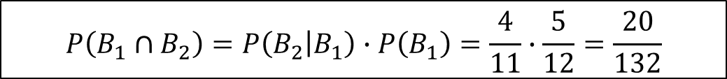
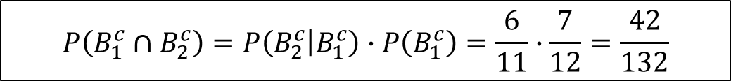
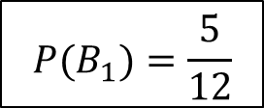

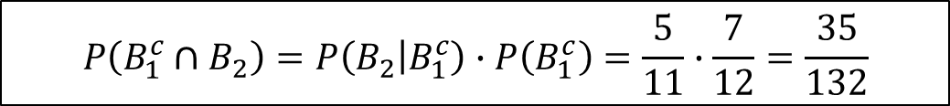
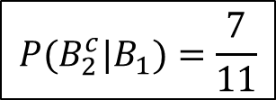
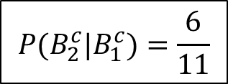
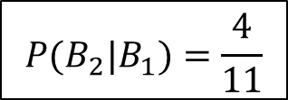
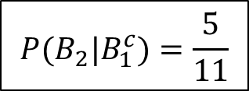
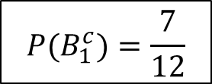
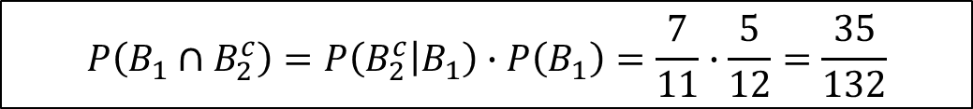
Conditional Probability
Example 1 – Representing Conditional Probabilities in a Tree Diagram
5 blue, 7 gray.
Find P(B₁ ∩ B₂), P(B₁ ∩ B₂^{c}), P(B₁^{c} ∩ B₂), P(B₁^{c} ∩ B₂^{c}).
$$P(B_{1})=\frac{5}{12}$$
$$P(B_{1}^{c})=\frac{7}{12}$$
$$P({B_{2}|B}_{1})=\frac{4}{11}$$
$$P({B_{2}^{c}|B}_{1})=\frac{7}{11}$$
By formula 10.8.2
$$P(B_{2}|B_{1}^{c})=\frac{5}{11}$$
$$P(B_{2}^{c}|B_{1}^{c})=\frac{6}{11}$$
$$P(A∩B)=P(B|A)∙P(A)$$
$$P\left(B_{1}∩B_{2}\right)=P\left(B_{2} | B_{1}\right)∙P\left(B_{1}\right)=\frac{4}{11}∙\frac{5}{12}=\frac{20}{132}$$
$$P\left(B_{1}∩B_{2}^{c}\right)=P\left(B_{2}^{c} | B_{1}\right)∙P\left(B_{1}\right)=\frac{7}{11}∙\frac{5}{12}=\frac{35}{132}$$
$$P\left({B_{1}^{c}∩B}_{2}\right)=P\left(B_{2} | B_{1}^{c}\right)∙P\left(B_{1}^{c}\right)=\frac{5}{11}∙\frac{7}{12}=\frac{35}{132}$$
$$P\left(B_{1}^{c}∩B_{2}^{c}\right)=P\left(B_{2}^{c} | B_{1}^{c}\right)∙P\left(B_{1}^{c}\right)=\frac{6}{11}∙\frac{7}{12}=\frac{42}{132}$$

Slide 16
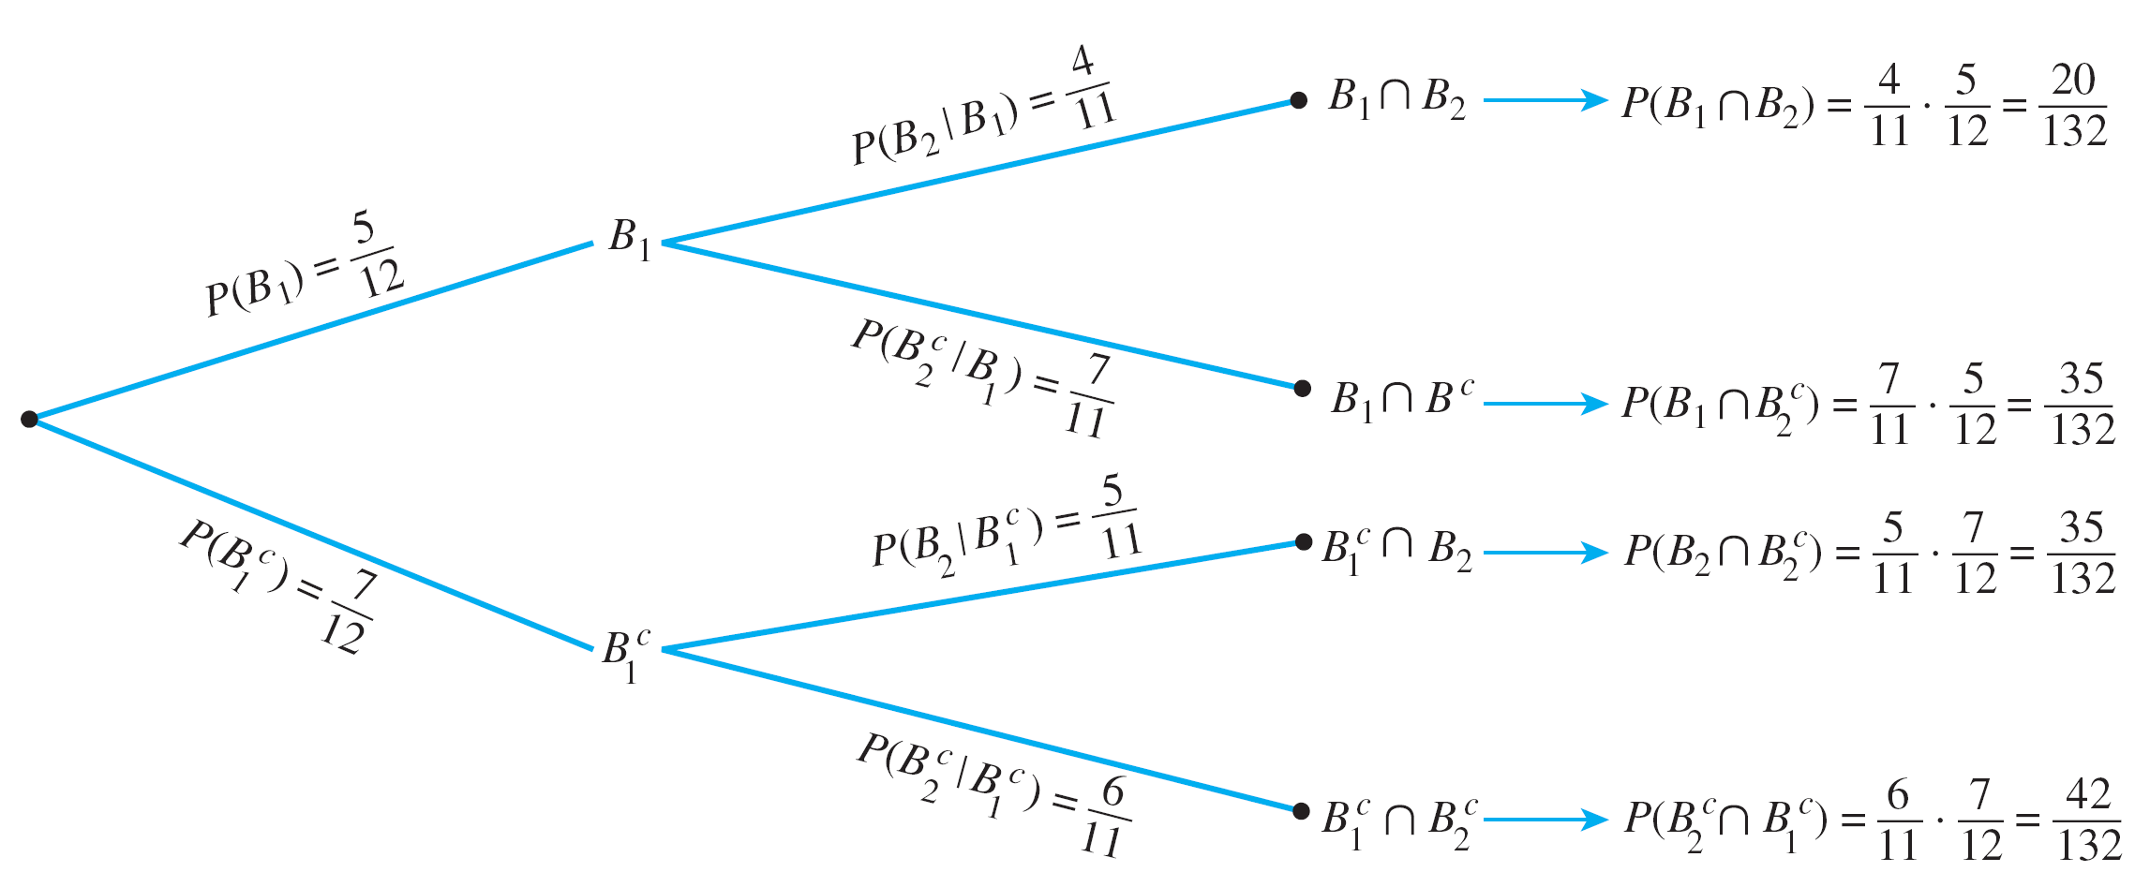
Conditional Probability
Example 1 – Representing Conditional Probabilities in a Tree Diagram
5 blue, 7 gray.
Find P(B₁ ∩ B₂), P(B₁ ∩ B₂^{c}), P(B₁^{c} ∩ B₂), P(B₁^{c} ∩ B₂^{c}).
2
Figure 11.8.2

Slide 17


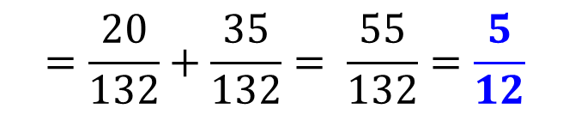
Conditional Probability
Example 1 – Representing Conditional Probabilities in a Tree Diagram
5 blue, 7 gray.
What is the probability that the 2nd ball is blue?
First ball is blue and second is also blue, OR
first ball is gray and second is blue.
They are mutually exclusive.
$$P\left(B_{2}\right)=P(\left(B_{2}∩B_{1}\right)∪\left(B_{2}∩B_{1}^{c}\right))$$
$$=P\left(B_{2}∩B_{1}\right)+P\left(B_{2}∩B_{1}^{c}\right)$$
by probability axiom 3
$$=\frac{20}{132}+\frac{35}{132}= \frac{55}{132}=\frac{5}{12}$$

Slide 18
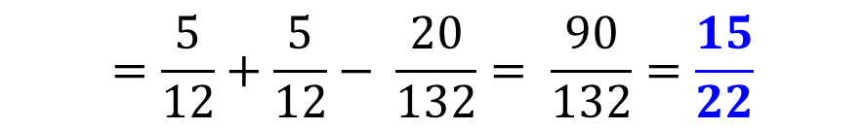
Conditional Probability
Example 1 – Representing Conditional Probabilities in a Tree Diagram
5 blue, 7 gray.
What is the probability that at least one ball is blue?
Probability of a General Union of Two Events
If A and B are any events in a sample space S, then
P(A ∪ B) = P(A) + P(B) – P(A ∩ B).
$$P\left(B_{1}∪B_{2}\right)=P\left(B_{1}\right)+P\left(B_{2}\right)− P\left(B_{1}∩B_{2}\right)$$
$$=\frac{5}{12}+\frac{5}{12}− \frac{20}{132}= \frac{90}{132}=\frac{15}{22}$$


Slide 19
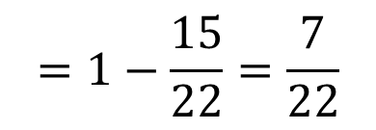

Conditional Probability
Example 1 – Representing Conditional Probabilities in a Tree Diagram
5 blue, 7 gray.
What are the probabilities of no blue ball, one blue ball and two blue balls?
$$=1−\frac{15}{22}=\frac{7}{22}$$
P(no blue balls) = 1 – P(at least one blue ball)
The event that one ball is blue → first ball is blue but second ball is not; or second ball is blue but first ball is not.
From part (a), $P\left(B_{1}∩B_{2}^{c}\right)=\frac{35}{132}$ and $P\left(B_{1}^{c}∩B_{2}\right)=\frac{35}{132}$
Hence, P(1 blue ball) $=\frac{35}{132}+ \frac{35}{132}=\frac{70}{132}$
From part (a), P(2 blue balls) $=\frac{20}{132}$

Slide 20

Bayes’ Theorem
Bayes’ Theorem
Suppose that one urn contains 3 blue and 4 gray balls and a second urn contains 5 blue and 3 gray balls. A ball is selected by choosing one of the urns at random and then picking a ball at random from that urn. If the chosen ball is blue, what is the probability that it came from the first urn?
This problem can be solved by carefully interpreting all the information that is known and putting it together in just the right way.
Let
A be the event that the chosen ball is blue,
B₁ the event that the ball came from the first urn, and
B₂ the event that the ball came from the second urn.

Slide 21
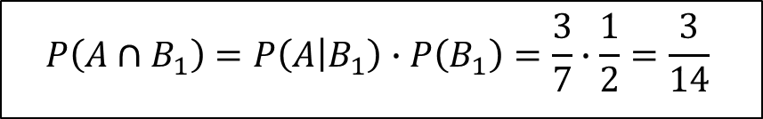

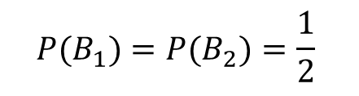
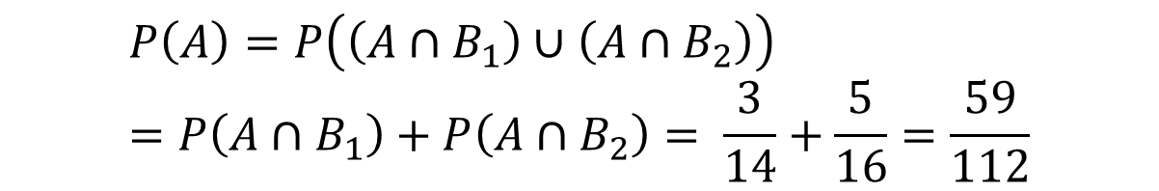

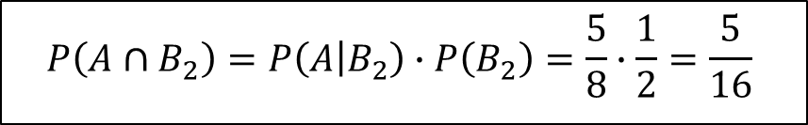
Bayes’ Theorem
Bayes’ Theorem
3 of the 7 balls in the first urn are blue, 5 of the 8 balls in the second urn are blue:
$P\left(A | B_{1}\right)=\frac{3}{7}$ and $P\left(A | B_{2}\right)=\frac{5}{8}$
The urns are equally like to be chosen:
$$P(B_{1})=P(B_{2})=\frac{1}{2}$$
By formula 10.8.2
$$P(A∩B)=P(B|A)∙P(A)$$
$$P\left(A∩B_{1}\right)=P\left(A | B_{1}\right)∙P\left(B_{1}\right)=\frac{3}{7}∙\frac{1}{2}=\frac{3}{14}$$
$$P\left(A∩B_{2}\right)=P\left(A | B_{2}\right)∙P\left(B_{2}\right)=\frac{5}{8}∙\frac{1}{2}=\frac{5}{16}$$
A is a disjoint union of $(A∩B_{1})$ and $(A∩B_{2})$, so by probability axiom 3,
$$P\left(A\right)=P\left(\left(A∩B_{1}\right)∪\left(A∩B_{2}\right)\right)=P\left(A∩B_{1}\right)+P\left(A∩B_{2}\right)= \frac{3}{14}+\frac{5}{16}=\frac{59}{112}$$

Slide 22
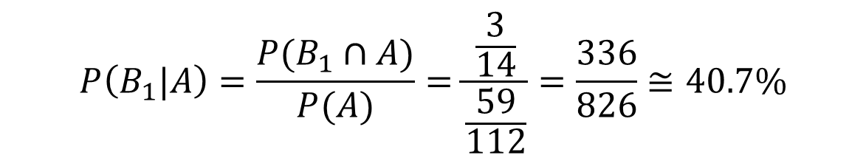
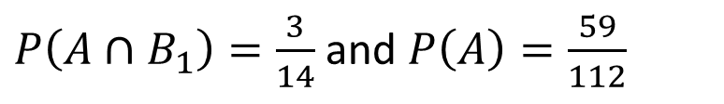
Bayes’ Theorem
Bayes’ Theorem
3 of the 7 balls in the first urn are blue, 5 of the 8 balls in the second urn are blue.
From previous slide,
$P\left(A∩B_{1}\right)=\frac{3}{14}$ and $P\left(A\right)=\frac{59}{112}$
By definition of conditional probability,
$$P\left(B_{1}|A\right)=\frac{P(B_{1}∩A)}{P(A)}=\frac{\frac{3}{14}}{\frac{59}{112}}=\frac{336}{826}≅40.7\%$$
Thus, if the chosen ball is blue, the probability that it came from the first urn is approximately 40.7%.

Slide 23
Bayes’ Theorem
Theorem 10.8.1 Bayes’ Theorem
Suppose that a sample space S is a union of mutually disjoint events B₁, B₂, B₃, …, B_{n}.
Suppose A is an event in S, and suppose A and all the B_{i} have non-zero probabilities.
If k is an integer with 1 ≤ k ≤ n, then
$$P\left(B_{k} | A\right)= \frac{P(A|B_{k})∙P(B_{k})}{P\left(A | B_{1}\right)∙P\left(B_{1}\right)+P\left(A | B_{2}\right)∙P\left(B_{2}\right)+⋯+P(A|B_{n})∙P(B_{n})}$$

Slide 24
Bayes’ Theorem
Example 2 – Applying Bayes’ Theorem
Most medical tests occasionally produce incorrect results, called false positives and false negatives.
When a test is designed to determine whether a patient has a certain disease:
A true positive result indicates that a patient has the disease when the patient has it.
A false positive result indicates that a patient has the disease when the patient does not have it.
A true negative result indicates that a patient does not have the disease when the patient does not have it.
A false negative result indicates that a patient does not have the disease when the patient does have it.

Slide 25
Bayes’ Theorem
Example 2 – Applying Bayes’ Theorem
Consider a medical test that screens for a disease found in 5 people in 1,000. Suppose that the false positive rate is 3% and the false negative rate is 1%.
That is, 3% of the time a person who does not has the condition tests positive for it, and 1% of the time a person who has the condition tests negative for it.
What is the probability that a randomly chosen person who tests positive for the disease actually has the disease?
What is the probability that a randomly chosen person who tests negative for the disease does not indeed have the disease?

Slide 26






Bayes’ Theorem
Example 2 – Applying Bayes’ Theorem
Consider a person chosen at random from among those screened. Let
A be the event that the person tests positive for the disease,
B₁ the event that the person actually has the disease, and
B₂ the event that the person does not have the disease.
Then, P(A|B₁) = 1 – P(A^{C}|B₁) and P(A^{C}|B₂) = 1 – P(A|B₂)
Hence,
$$P\left(A^{c} | B_{1}\right)=0.01$$
$$P\left(A | B_{2}\right)=0.03$$
$$P\left(A | B_{1}\right)=0.99$$
$$P\left(A^{c} | B_{2}\right)=0.97$$
Also, because 5 people in 1000 have the disease,
$$P(B_{1})=0.005$$
$$P(B_{2})=0.995$$

Slide 27
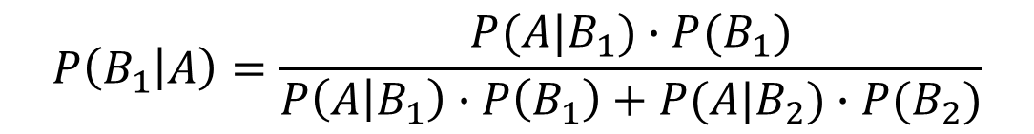

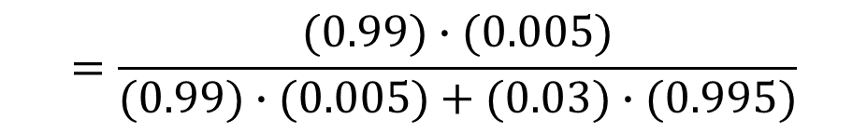
Bayes’ Theorem
Example 2 – Applying Bayes’ Theorem
What is the probability that a randomly chosen person who tests positive for the disease actually has the disease?
By Bayes’ Theorem,
$$P\left(B_{1} | A\right)=\frac{P(A|B_{1})∙P(B_{1})}{P\left(A | B_{1}\right)∙P\left(B_{1}\right)+P(A|B_{2})∙P(B_{2})}$$
$$=\frac{(0.99)∙(0.005)}{(0.99)∙(0.005)+(0.03)∙(0.995)}$$
$$≅0.1422 ≅14.2\%$$
Thus the probability that a person with a positive test result actually has the disease is approximately 14.2%.

Slide 28
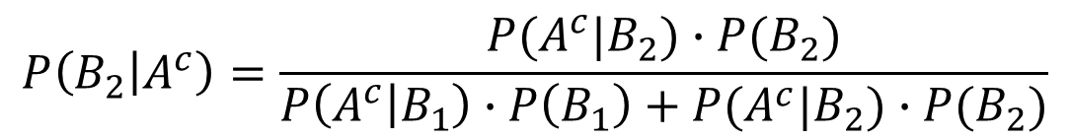

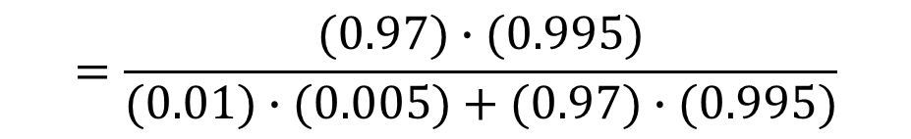
Bayes’ Theorem
Example 2 – Applying Bayes’ Theorem
What is the probability that a randomly chosen person who tests negative for the disease does not indeed have the disease?
By Bayes’ Theorem,
$$P\left(B_{2} | A^{c}\right)=\frac{P(A^{c}|B_{2})∙P(B_{2})}{P\left(A^{c} | B_{1}\right)∙P\left(B_{1}\right)+P(A^{c}|B_{2})∙P(B_{2})}$$
$$=\frac{(0.97)∙(0.995)}{(0.01)∙(0.005)+(0.97)∙(0.995)}$$
$$≅0.999948 ≅99.995\%$$
Thus the probability that a person with a negative test result does not have the disease is approximately 99.995%.

Slide 29
Independent Events
For convenience and to eliminate the requirement that the probabilities be nonzero, we use the following product formula to define independent events.
Definition: Independent Events
If A and B are events in a sample space S, then A and B are independent, if and only if,
P(A ∩ B) = P(A) ⋅ P(B)

Slide 30
Independent Events
Example 3 – Computing Probabilities of Intersections of Two Independent Events
A coin is loaded so that the probability of heads is 0.6. Suppose the coin is tossed twice. Although the probability of heads is greater than the probability of tails, there is no reason to believe that whether the coin lands heads or tails on one toss will affect whether it lands heads or tails on the other toss. Thus it is reasonable to assume that the results of the tosses are independent.
What is the probability of obtaining two heads?
What is the probability of obtaining one head?
What is the probability of obtaining no heads?
What is the probability of obtaining at least one head?

Slide 31
Independent Events
Example 3 – Computing Probabilities of Intersections of Two Independent Events
Sample space S consists of the 4 outcomes {HH, HT, TH, TT} which are not equally likely.
Let
E be the event that a head is obtained on the first toss
F be the event that a head is obtained on the second toss
P(E) = P(F) = 0.6.

Slide 32
Independent Events
Example 3 – Computing Probabilities of Intersections of Two Independent Events
What is the probability of obtaining two heads?
P(two heads) = P(E ∩ F) = P(E) ⋅ P(F) = (0.6)(0.6) = 0.36 = 36%
What is the probability of obtaining one head?
P(one head) = P((E ∩ F^{c}) ∪ (E^{c} ∩ F)) = P(E) ⋅ P(F^{c}) + P(E^{c}) ⋅ P(F)
= (0.6)(0.4) + (0.4)(0.6) = 0.48 = 48%
What is the probability of obtaining no heads?
P(no heads) =
P(E^{c} ∩ F^{c}) = P(E^{c}) ⋅ P(F^{c}) = (0.4)(0.4) = 0.16 = 16%


Slide 33
Independent Events
Example 3 – Computing Probabilities of Intersections of Two Independent Events
What is the probability of obtaining at least one head?
Method 1:
P(at least one head) = P(one head) + P(two heads) = 0.48 + 0.36
= 0.84 = 84%
Method 2:
P(at least one head) = 1 – P(no heads) = 1 – 0.16 = 0.84 = 84%

Slide 34
Pairwise Independent/Mutually Independent
Pairwise Independent/Mutually Independent
We say three events A, B, and C are pairwise independent if, and only if,
P(A ∩ B) = P(A) ⋅ P(B)
,
P(A ∩ C) = P(A) ⋅ P(C)
and
P(B ∩ C) = P(B) ⋅ P(C)
Events can be pairwise independent without satisfying the condition
P(A ∩ B ∩ C) = P(A)  P(B)  P(C).
Conversely, they can satisfy the condition
P(A ∩ B ∩ C) = P(A)  P(B)  P(C) without being pairwise independent.

Slide 35
Pairwise Independent/Mutually Independent
Four conditions must be included in the definition of independence for three events
Definition: Pairwise Independent and Mutually Independent
Let A, B and C be events in a sample space S. A , B and C are pairwise independent, if and only if, they satisfy conditions 1 – 3 below. They are mutually independent if, and only if, they satisfy all four conditions below.
P(A ∩ B) = P(A) ⋅ P(B)
P(A ∩ C) = P(A) ⋅ P(C)
P(B ∩ C) = P(B) ⋅ P(C)
P(A ∩ B ∩ C) = P(A) ⋅ P(B) ⋅ P(C)

Slide 36
Pairwise Independent/Mutually Independent
The definition of mutual independence for any collection of n events with n ≥ 2 generalizes the two definitions given previously.
Definition: Mutually Independent
Events A₁, A₂, …, A_{n} in a sample space S are mutually independent if, and only if, the probability of the intersection of any subset of the events is the product of the probabilities of the events in the subset.

Slide 37
Pairwise Independent/Mutually Independent
Example 4 – Tossing a Loaded Coin Ten Times
A coin is loaded so that the probability of heads is 0.6 (and thus the probability of tails is 0.4). Suppose the coin is tossed ten times. As in Example 3, it is reasonable to assume that the results of the tosses are mutually independent.
What is the probability of obtaining eight heads?
What is the probability of obtaining at least eight head?
For each i = 1, 2, . . . , 10, let H_{i} be the event that a head is obtained on the i- th toss, and let T_{i} be the event that a tail is obtained on the i- th toss.

Slide 38
Pairwise Independent/Mutually Independent
Example 4 – Tossing a Loaded Coin Ten Times
What is the probability of obtaining eight heads?
Suppose that the eight heads occur on the first eight tosses and that the remaining two tosses are tails. This is the event
H₁ ∩ H₂ ∩ H₃ ∩ H₄ ∩ H₅ ∩ H₆ ∩ H₇ ∩ H₈ ∩ T₉ ∩ T₁₀.
For simplicity, we denote it as HHHHHHHHTT.
By definition of mutually independent events,
P(HHHHHHHHTT) = (0.6)⁸(0.4)²
By commutative law for multiplication, if the eight heads occur on any other of the ten tosses, the same number is obtained. Eg:
P(HHTHHHHHTH) = (0.6)²(0.4)(0.6)⁵(0.4)(0.6) = (0.6)⁸(0.4)²

Slide 39
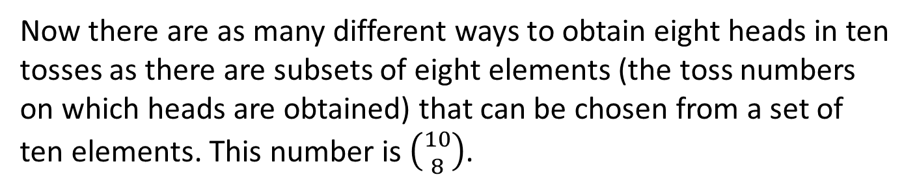

Pairwise Independent/Mutually Independent
Example 4 – Tossing a Loaded Coin Ten Times
What is the probability of obtaining eight heads?
Now there are as many different ways to obtain eight heads in ten tosses as there are subsets of eight elements (the toss numbers on which heads are obtained) that can be chosen from a set of ten elements. This number is $\left({10 \atop 8}\right)$.
Hence
P(eight heads) = $\left({10 \atop 8}\right)$(0.6)⁸(0.4)²

Slide 40
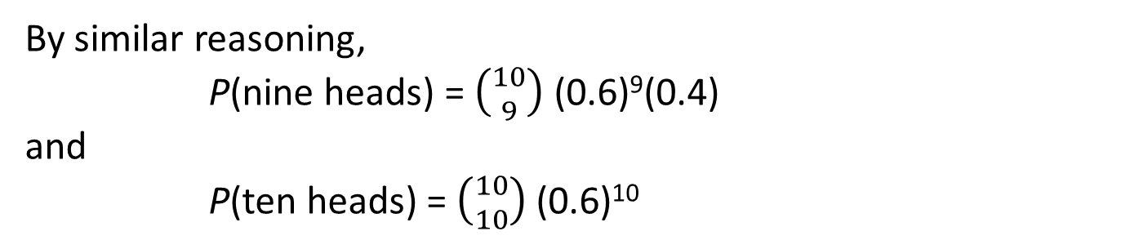
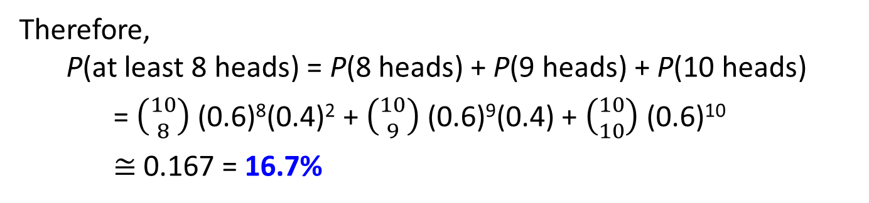
Pairwise Independent/Mutually Independent
Example 4 – Tossing a Loaded Coin Ten Times
What is the probability of obtaining at least eight heads?
By similar reasoning,
P(nine heads) = $\left({10 \atop 9}\right)$(0.6)⁹(0.4)
and
P(ten heads) = $\left({10 \atop 10}\right)$(0.6)¹⁰
Therefore,
P(at least 8 heads) = P(8 heads) + P(9 heads) + P(10 heads)
= $\left({10 \atop 8}\right)$(0.6)⁸(0.4)² + $\left({10 \atop 9}\right)$(0.6)⁹(0.4) + $\left({10 \atop 10}\right)$(0.6)¹⁰
$≅$ 0.167 = 16.7%

Slide 41
End of Unit 11

